Slide 1
AYAN DEEP HAZRA NLP GROUP 02/23/2021

Slide 2
1) Data Descriptor: Auto-generated materials database of Curie and Néel temperatures via semi-supervised relationship extraction
Summary: Work presents a method to generate a fully auto-generated database of 39,822 Curie and Néel phase transition temperature records.
Acquiring corpus
Data Extraction
Training a semi-supervised relationship extraction algorithm
Finding new relationships

Slide 3
Limitations of CDE: CDE is much better with organic compounds and not so much with inorganic compounds. It often fails to provide the chemical formulae or fails to link the needed property (say Neel temperature) for the said compound.
Solution? A set of new Chemical Entity Mention (CEM) parsing rules have been added to extract the correct compound names and labels for these cases.
Limitations of this approach: Firstly, whenever a user wishes to update CDE to extract new properties, a whole new set of rules must be programmed. Secondly, the information extraction is guaranteed to fail on sentences that are just a tad bit different from the said rule.

Slide 4
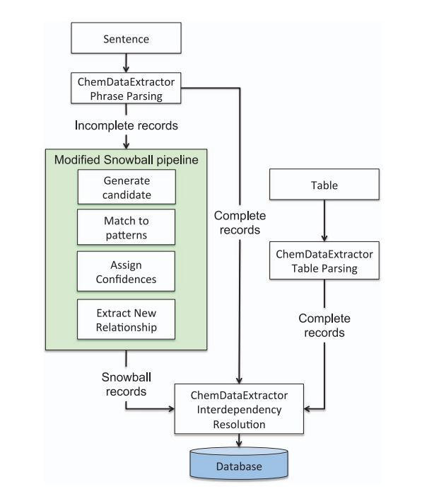
CDE’s Snowball Algorithm
Over 90% precision for simple binary relation extraction.
But we need to generalize to quaternary relations such as a property specifier, a CEM or label, the property value and the property unit.

Slide 5
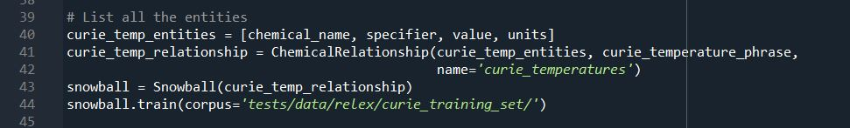
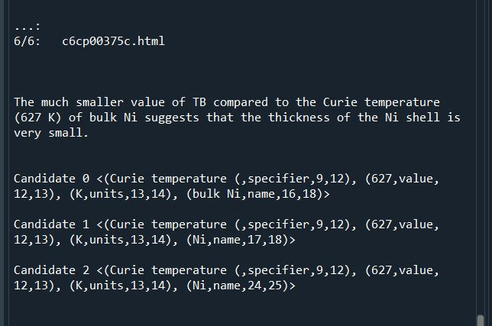
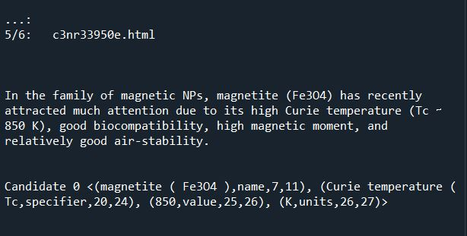
4 tuple of fields
Directory with .html files

Slide 6
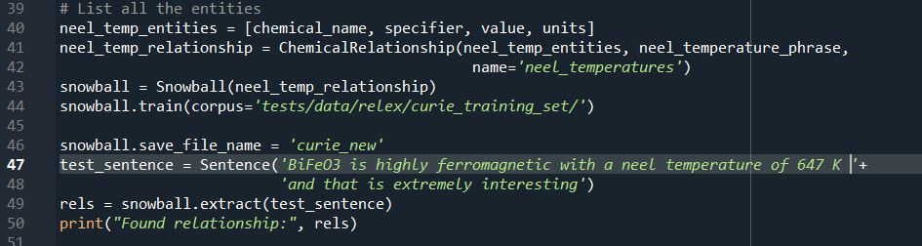
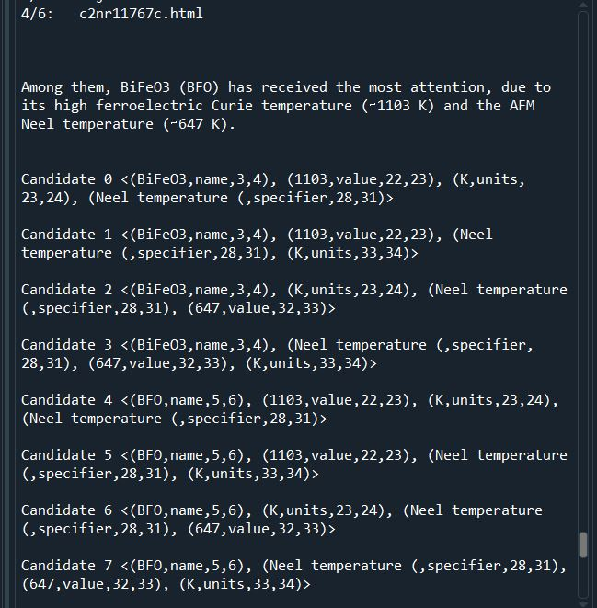
Repeated the code with keyword Neel temperature, on the same dataset.
Expected no results but one source was large and included data on both Curie and Neel temperatures.

Slide 7
Next Steps
Understand how to integrate the changes to CDE that Ref 3 suggested and try to reproduce the results.
Read more into the literature and explore for more optimizations/better ways of getting the desired output.

Slide 8
Summary of Work
Date | Hours Worked | Description
02/20/2021 | 3 | Read Neels/Curie Temp paper
02/21/2021 | 1 | Read Ref 1
02/22/2021 | 2 | Started to look at software packages for CDE and Snowball
02/23/2021 | 5 | Wrapped up trying to implement rules from ref 1 into Python

